Slide 1









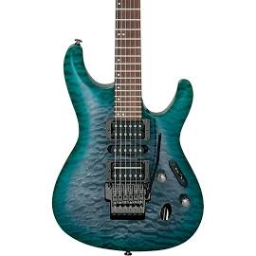
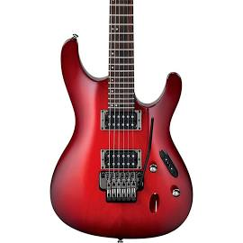
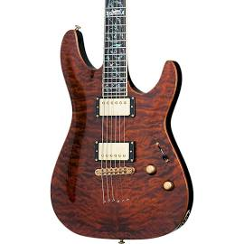
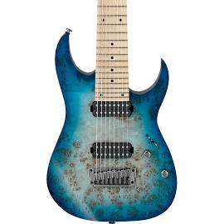
Web page title
http://www.url.com
K I N G R O Y A L S
Sign Up
Log In
S T R I N G S P E R C U S S I O N B R A S S W I N D A C C E S S O R I E S
Quality Instruments
Quality Prices
Check out these best sellers…

Slide 2




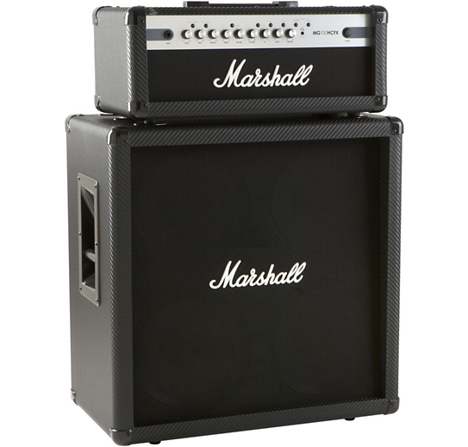
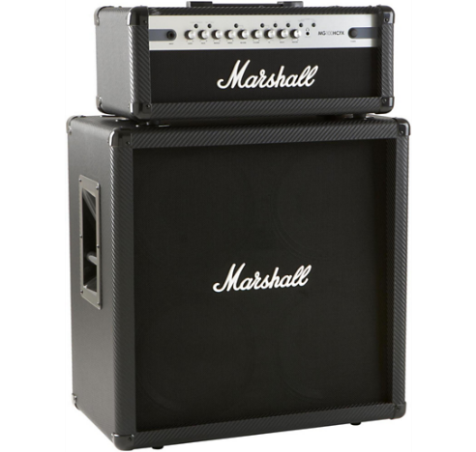
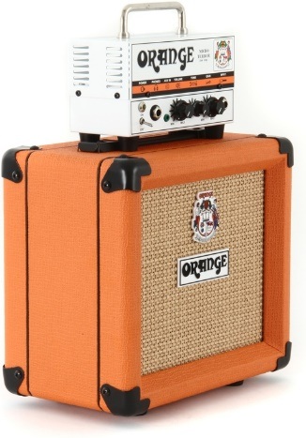
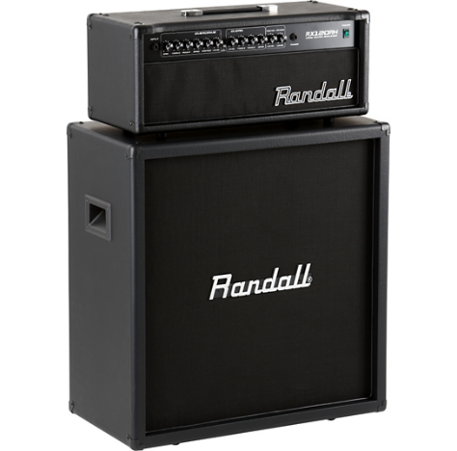
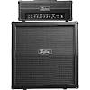
Web page title
http://www.url.com
text
Ibanez S5570Q Prestige Electric Guitar
$1,299.00
Ibanez S520 BlackBerry Sunburst Guitar
$399.00
Schecter C-1 Classic Amber Electric Guitar
$599.99
Ibanez Prestige RG852 8-String Guitar
$1,499.00

Slide 3


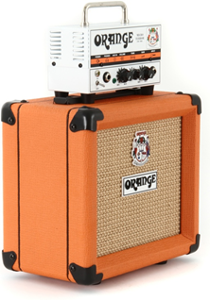
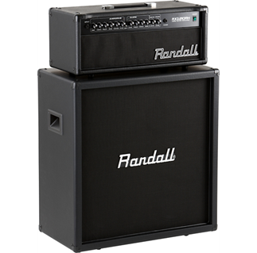
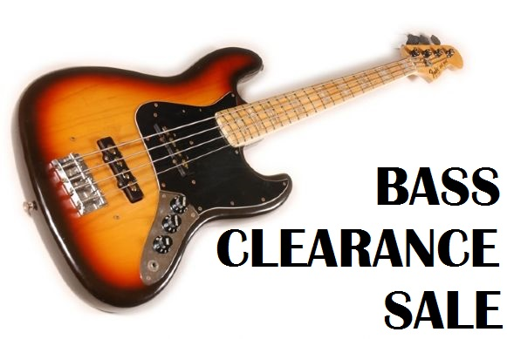
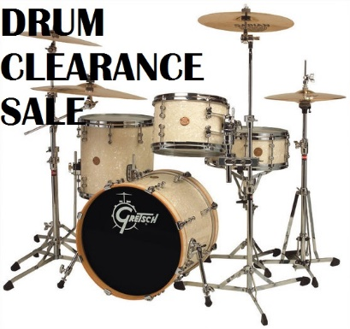
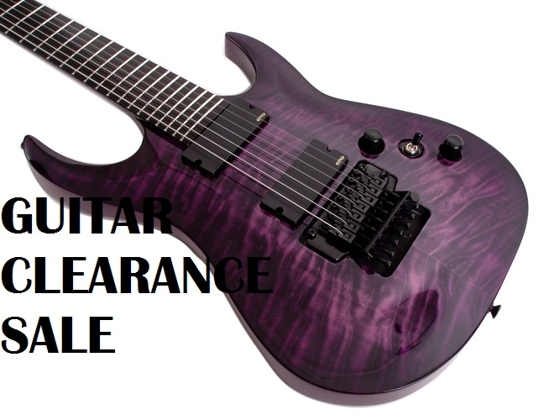
Web page title
http://www.url.com
Kustom KG100HFX Black Slant Half Stack
$199.99
Marshall MG100 HCFX Half Stack
$499.99
Orange Micro Terror Head and PPC108 Cabinet
$199.99
Randall RX 120RH Half Stack
$299.99
We strive to give you the best products with unbeatable deals.

Slide 4
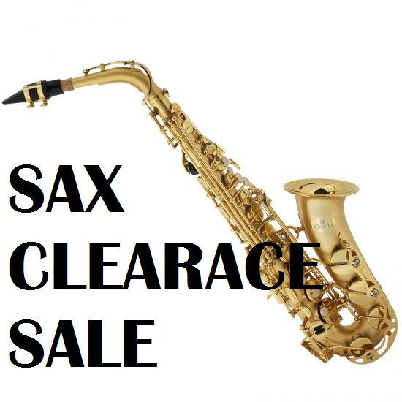
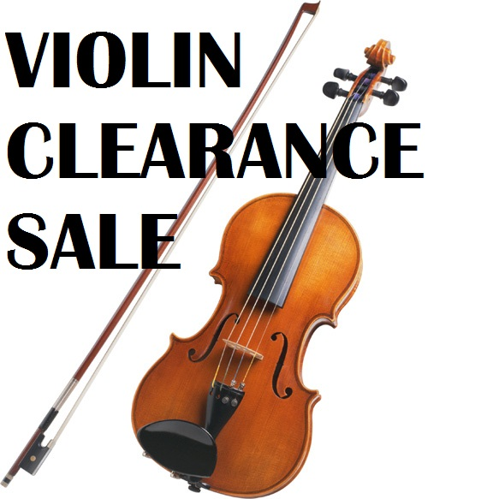
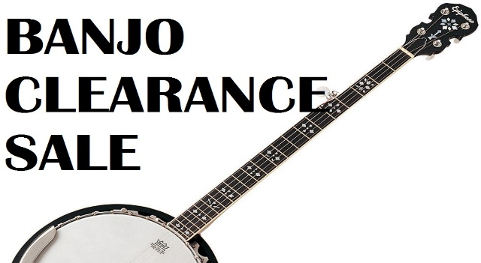
x
King Royals Music Store
https://www.kingroyals.com
We strive to give you the best products with unbeatable deals.

Slide 5


Web page title
http://www.url.com
King Royals
Contact Us
Phone & Store Hours
1822 Turkey Rd,
304-555-1294
Mon-Fri : 7:00am – 11:00pm
Ripley, WV, 25271
isaacvidrine@kingroyals.com
Saturday : 10:00am – 8:00pm
Sunday: Closed

Slide 6



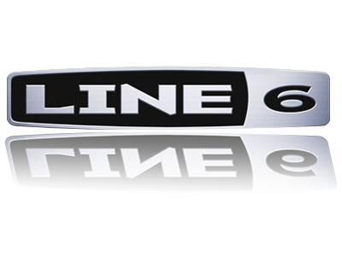

Web page title
http://www.url.com
King Royals
Contact Us
Phone & Store Hours
1822 Turkey Rd,
304-555-1294
Mon-Fri : 7:00am – 11:00pm
Ripley, WV, 25271
isaacvidrine@kingroyals.com
Saturday : 10:00am – 8:00pm
Sunday: Closed

Slide 7
Web page title
http://www.url.com
K I N G R O Y A L S
Sign Up
Log In
S T R I N G S P E R C U S S I O N B R A S S W I N D A C C E S S O R I E S
Quality Instruments
Quality Prices
Check out these best sellers…

Slide 8
Web page title
http://www.url.com
K I N G R O Y A L S
Sign Up
Log In
S T R I N G S P E R C U S S I O N B R A S S W I N D A C C E S S O R I E S
Guitar
Bass
Quality Instruments
Banjo
Violin
Quality Prices
Check out these best sellers…

Slide 9
Web page title
http://www.url.com
K I N G R O Y A L S
Sign Up
Log In
S T R I N G S P E R C U S S I O N B R A S S W I N D A C C E S S O R I E S
Drum Kits
Snares
Quality Instruments
Bongos
Pianos
Quality Prices
Check out these best sellers…

Slide 10
Web page title
http://www.url.com
K I N G R O Y A L S
Sign Up
Log In
S T R I N G S P E R C U S S I O N B R A S S W I N D A C C E S S O R I E S
Trumpets
Horns
Quality Instruments
Tubas
Trombones
Quality Prices
Check out these best sellers…

Slide 11
Web page title
http://www.url.com
K I N G R O Y A L S
Sign Up
Log In
S T R I N G S P E R C U S S I O N B R A S S W I N D A C C E S S O R I E S
Flute
Quality Instruments
Oboe
Clarinet
Bassoon
Quality Prices
Check out these best sellers…

Slide 12
Web page title
http://www.url.com
K I N G R O Y A L S
Sign Up
Log In
S T R I N G S P E R C U S S I O N B R A S S W I N D A C C E S S O R I E S
Cables
Quality Instruments
Mic Stands
Guitar Wall Mounts
Cases
Quality Prices
Check out these best sellers…

Slide 13
Web page title
http://www.url.com
K I N G R O Y A L S
Sign Up
Log In
S T R I N G S P E R C U S S I O N B R A S S W I N D A C C E S S O R I E S
Cables
Quality Instruments
Mic Stands
Guitar Wall Mounts
Cases
Quality Prices
Check out these best sellers…

Slide 14
Web page title
http://www.url.com
K I N G R O Y A L S
Sign Up
Log In
S T R I N G S P E R C U S S I O N B R A S S W I N D A C C E S S O R I E S
Quality Instruments
Quality Prices
What kind of case do you need?
Acoustic Guitar
Electric Guitar
Bass Guitar
Violin
Cello
Trumpet

Slide 15
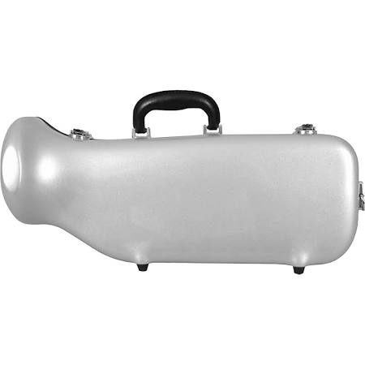
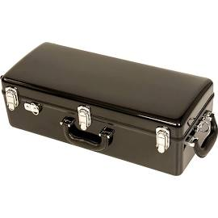
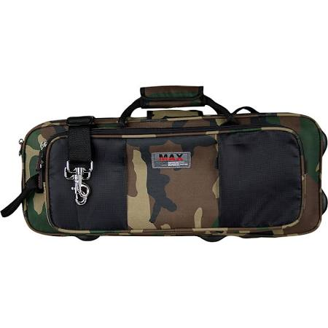
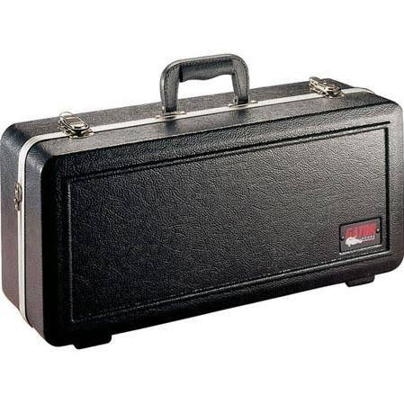
Web page title
http://www.url.com
K I N G R O Y A L S
Sign Up
Log In
S T R I N G S P E R C U S S I O N B R A S S W I N D A C C E S S O R I E S
Quality Instruments
Quality Prices
J. Winter CE 170 Hard shell Trumpet Case
$199.99
Gator Case Hard Shell Trumpet Case
$99.99
J. Winter CE 175 Hard Shell Trumpet Case
$99.99
ProtecMax Camouflage Trumpet Case
$75.99

Slide 16
Web page title
http://www.url.com
K I N G R O Y A L S
Sign Up
Log In
S T R I N G S P E R C U S S I O N B R A S S W I N D A C C E S S O R I E S
Quality Instruments
Quality Prices
Check out these best sellers…

Slide 17
Web page title
http://www.url.com
K I N G R O Y A L S
Sign Up
Log In
S T R I N G S P E R C U S S I O N B R A S S W I N D A C C E S S O R I E S
Quality Instruments
Quality Prices
Username/Email
Password
Log In
I forgot my password

